Slide 1
Graduation Project
OVERVIEW

Slide 2
Promote a service ( VA Agency)
A virtual assistant agency is: an agency that gives busy professionals a remote assistance service by matching the client with the right assistant, and that helps the client to have a work-life balance, more productive and career growth. Who is a virtual assistant?
An assistant who works remotely with clients and assists them by taking administrative tasks off their plate to help them focus on the core work.
The agency provides the client with a certificated and well-trained VA with a background in the client’s field to meet their needs.

Slide 3
Tasks Virtual Assistants Do
Managing a client’s inbox.
taking minutes/ notes.
Customer service/stakeholder management.
Social media management.
Expense tracking.
Managing a client’s calendar.
Scheduling.
Internet research.
Creating slides/ presentations.
Project management.
Travel research and booking.
Creating travel itineraries.
Data entry.
Creating meeting agenda.
And other tasks related to the client’s field.

Slide 4
Our Marketing Objective
To build awareness for the VA agency in the Egyptian Market.
To spread awareness of what virtual assistants are, what they do, and how they add value to the client’s lives.

Slide 5
Market research of the role of VA
Based on our research, we found that most of the clients don’t fully understand what a VA does and some of them aren’t aware of the existing of a VA.
VA vs. Secretary: People assume VAs are just remote secretaries, but VAs offer specialized services like social media management, email marketing, automation, etc.
VA vs. Junior Employees: Businesses tend to hire juniors instead of considering VAs, not realizing that VAs provide expertise and flexibility without long-term employment costs.
Misunderstanding Among VAs Themselves: Many Egyptian VAs limit themselves to administrative tasks without realizing the full potential of the role.

Slide 6
Competitor Analysis
Comparison points | Va agency | Professional VA | Mid-level VA
The Price | Hourly packages 2k to 6k and additional packages if needed | From 200 to 500 for 6 hrs per day Hourly packages for month starts from 6k to 12k | The charge is less than 200l.e per hour
Services | The essential tasks that any VA should have | the essential tasks that any VA should have | They don’t provide the client with full assistance and they offer some of the essential tasks
specialization | Our VAs are specialized and have a strong background in the client’s field | They give basic assistance and they need training to gain knowledge of the client’s field | They stick to the kind of tasks they do
Quality assurance and confidentiality | Our VAs are trained and have supportive systems and mentors. We provide legal contracts to protect the clients right | The only way to know that is through the experience itself and that costs time and money | The only way to know that is through the experience itself and that costs time and money
Marketing strategies | We market our services through different channels to spread awareness and to reach our clients | Only exists on freelance websites | Only exists on freelance websites

Slide 7
Our target audience
Age: from 30 to 50
Gender: male or female
Income: high income at least 30k a month
Occupation: freelancers, CEOs, high-income services like ( Doctors, lawyers, famous teachers, ….etc.), E-commerce owners
1. Behavior & Lifestyle: Work long hours, often overwhelmed with tasks and time management. Struggle with balancing core business activities and administrative work. Feel constantly busy, trying to expand their business, gain more clients, or increase sales.
2. Interests & Aspirations: Focused on growth, self-improvement, and staying competitive in their industry. Actively engage with LinkedIn, social media, motivational content, and market trends to stay updated. Interested in health and wellness for productivity and work-life balance. They want to increase income, improve skills, and scale their business efficiently.
3. Pain Points & Challenges: Burnout due to handling everything alone. Limited time prevents them from taking on more clients or expanding. Administrative tasks consume time that should be spent on core business functions. Lack of awareness about virtual assistants—many only know about in-office secretaries.
Rely on junior hires, who later leave and take clients, leading to trust issues.

Slide 8
Personas
Ahmed | Reem | Nour | Ehab
Age: 30 | Location: التجمع Mid-level freelancer Marketer | Age: 35 | location Zaid Aesthetic doctor | Age: 27 | Location: المهندسين Micro- influencer | Age:40 | Location: زايد M&A Advisor| corporate lawyer
Challenges: Overwhelmed with administrative tasks, customer service, meetings and landing new clients | Challenges: managing her calendar, clinics, Attending conferences, traveling, her personal life. | Challenges: overwhelmed with SMM, and handling brand deals, editing, keeping up with trends and creating content | Managing heavy workload & client communicationsScheduling meetings & handling contractsKeeping up with legal updates & market trendsOrganizing case files & documentation
Goals& motivation: Wants to take more projects, update their skills, increase their income | Goals& Motivation: wants to open more clinics, have clients from the Gulf countries, stay up to date with work | Grow her personal brand and increase her followersStay updated on industry trends and best practicesSecure more brand collaborations and sponsorshipsMaintain consistent content posting and audience engagementOptimize workflow to free up time for creativity | Expanding his client base & networkStaying updated on corporate laws & M&A trendsImproving efficiency & work-life balanceHandling high-profile cases smoothly
Value the VA would add: take the administrative tasks, customer services, SMM, landing more clients off his plate | Value VA: take the administrative tasks, plan travels, do research, SMM, handle personal tasks and more | SMM: Scheduling, posting, engagementAdmin tasks: Emails, brand deals, outreachEditing & content: Video/photo editing, repurposingTrend research: Updates on trends, hashtags, algorithmsBrand outreach: Finding & managing partnershipsBrainstorming: Content ideas, strategy, audience engagement | Admin support: Scheduling, emails, client follow-upsLegal research: Summarizing updates, case trackingDocument management: Organizing contracts & filesClient outreach: Preparing proposals, networking assistance

Slide 9
Project Plan
milestone | Description | Due Date
Research strategy development | Define target audience, content pillars, competitors analysis, key messages | 10/2/2025
content creation and optimization | Develop content aligned with audience pain points and interests. | 28/3/2025
Organic social media launch | Start posting on the channels and engage with our audience | 1/3/2025
Community building & engagement | Increase interactions via comments, dms, stories | In progress with content
Performance &review adjustments | Analyze performance then optimize strategy | In progress with content
Paid campaign planning | Prepare ad creatives, audience targeting, and budget allocation. | 19/3/2025
launch paid campaigns | Start running targeted awareness ads | 20/3/2025
Final performance analysis | Evaluate overall success, engagement and conversions | 5/4/2025

Slide 10
Project Plan
Deliverables:✔️ Social media content (posts, reels, carousels, stories)✔️ Engagement strategy✔️ Performance reports✔️ Paid campaign setup
Tools: Canva, Cup Cut, Buffer, Meta Business Suite, LinkedIn, Tik Tok, Ads, etc.
Budget: [ Paid Ads: Specify later]
Time: we have deadlines and we do meetings from 2 to 3 times per week to be on the same page discuss the details and update each other.

Slide 11
Task assignment and roles
The Role | Description | Assigned to
Marketing Researcher | Competitor analysis, industry trends, and market insights. | Omnia amin
Social Media Manager | Handles social media presence, posting, engagement, and platform strategies. | Eman Magdy
Content Writer | Produces and written content, and captions.
Media Buyer | Manages paid advertising campaigns across platforms
Creative Strategist | Plans ad creatives and overall campaign themes. | Mariam Mohammed Hussein
Content Strategist | Develops content plans, ensuring consistency and alignment with goals. | Mariam Mohammed Hussein
Copywriter | Writes persuasive marketing copy, including ads, social media posts, and landing pages. | Yumna
Data Analyst | Tracks campaign performance, analyzes insights, and suggests optimization | Omnia amin
Side note | All the team members are involved in every role since we all work as a team and we decide | All team members are collaboratively involved in each aspect of the project. While each role has a primary responsibility, tasks are refined through group brainstorming, feedback, and collective approval to ensure alignment with our strategy and goals.

Slide 12
KPI Metrix
1. Brand Awareness Metrics: Reach & Impressions – Number of unique users who see posts, stories, and videos. Follower Growth Rate – Increase in followers across Facebook, Instagram, TikTok, LinkedIn, and YouTube Shorts. Profile Visits – How many people check your profiles after seeing content.
2. Engagement Metrics: Engagement Rate (Likes, Shares, Comments, Saves) – The percentage of engagement relative to reach. Average Watch Time – How long users watch videos (important for TikTok & YouTube Shorts).Story & Reel Interaction Rate – Replies, shares, and taps on IG & FB stories and reels.
3. Content Performance Metrics: Video Views – Total views on TikTok, Reels, YouTube Shorts. Share Rate – How often users share the content. Click-Through Rate (CTR) on Social Posts ( depends on the content – If using call-to-action buttons (e.g., "DM us" or "Visit our page").
4. Lead Generation & Action Metrics: DMs & Inquiries – Number of potential clients reaching out via social media messages. Form Fills.

Slide 13
SWOT Analysis
Strength points: INTERNAL/POSITIVE 1/ certified VAs 2/ Long term Contracts 3/ Different Niches 4/ switching VA without extra fees or new package so the client would have a new VA within the same package 5/ flexibility 6/ the VA are trained and has mentors | Weaknesses points: INTERNAL/NEGATIVE 1/ no reviews 2/ startup 3/ sources 4/ New to the Market 5/ The service its self as agency is not common in Egypt 6/ The market is not fully aware about the service
Opportunities points: the only VA agency in Egypt. | Threats: Freelancers VAs Unknown services Economic issues

Slide 14
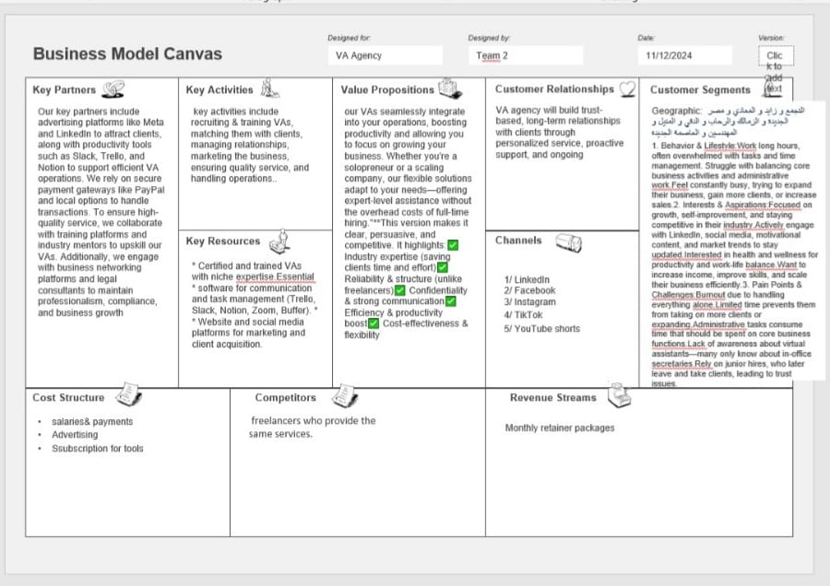
Business model canvas

Slide 15
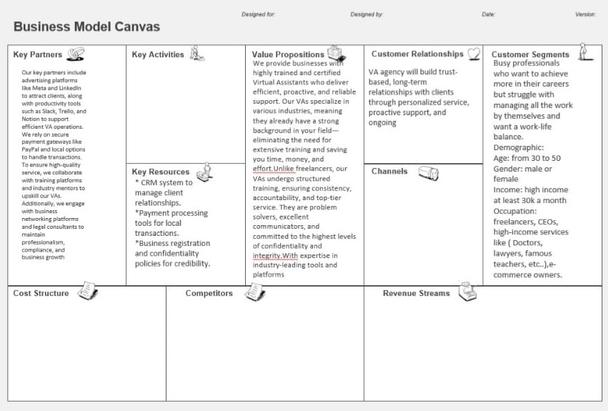
Business Model Cnvas

Slide 16
Team INFO
VA agency
YAT323A_GIZ2_DRT1_G2_DEPI2
Group2
Mariam mohammed hussein
Omnia Amin
Mariam Mustafa
Eman Magdy
Yomna Mohammed
Nada Al sayed

